Slide 1
Email Forensics

Slide 2
Introduction

Slide 3
Motivation for email investigations
Email has become a primary means of communication
Email has lots of important evidence for investigation
Spam
Crime
Harassment

Slide 4
Examples of the use of e-mail as evidence
Enron
Knox vs. State of Indiana
Harley vs. McCoach
Nardinelli et al. vs. Chevron
Adelyn Lee vs. Oracle Corporation

Slide 5
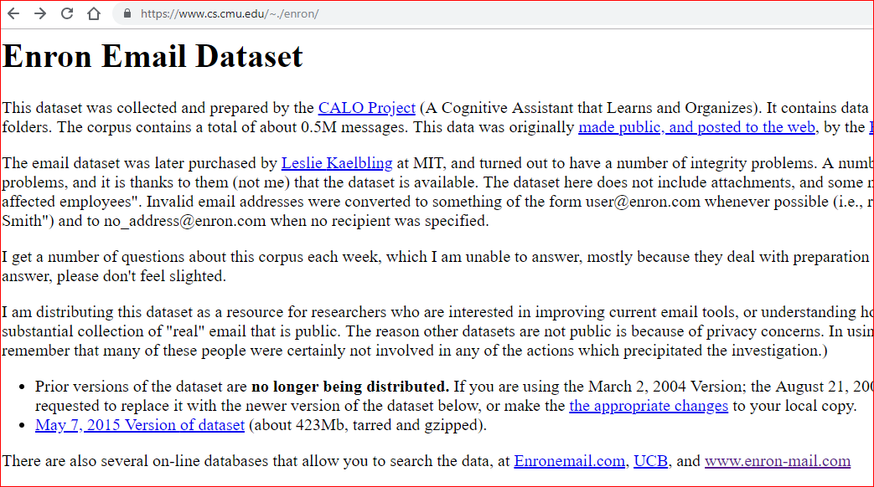

Slide 6
Email application types
Client/server applications
MS outlook
Webmail
gmail

Slide 7
How email really works

Slide 8
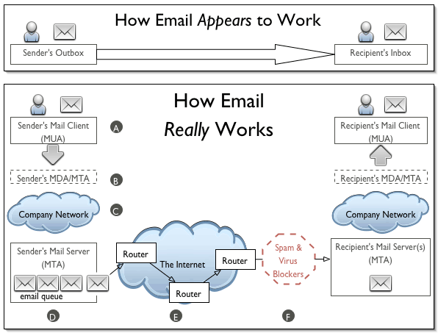
Mail User Agent (MUA)
Mail Delivery Agent (MDA)
Mail transfer agent (MTA)
https://www.oasis-open.org/khelp/kmlm/user_help/html/how_email_works.html

Slide 9
Nuno Santos | Technical University of Lisbon, Lisbon
Simple Mail Transfer Protocol (SMTP): an Internet standard for email transmission.

Slide 10
Email client protocols 1 (POP3)
Post Office Protocol version 3 (POP3)
Retrieve emails from email servers
Remove from the server
Limited functions, but easier to implement
Becoming obsolete
Investigation must be at the workstation.

Slide 11
Email client protocols 2 (IMAP)
Internet Message Access Protocol (IMAP)
default to leaving the message on the email server, simply downloading a local copy.
Investigation can be at the workstations and servers.
Microsoft Outlook, Thunderbird

Slide 12
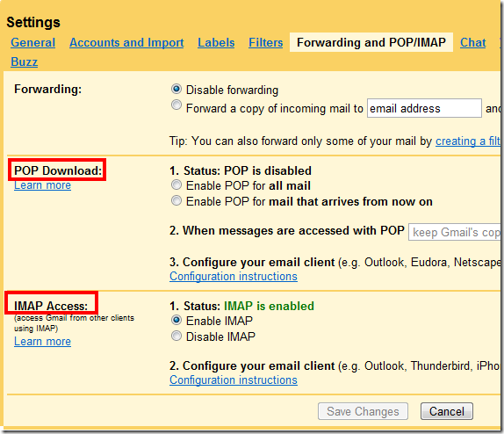
How to activate protocols: Gmail

Slide 13
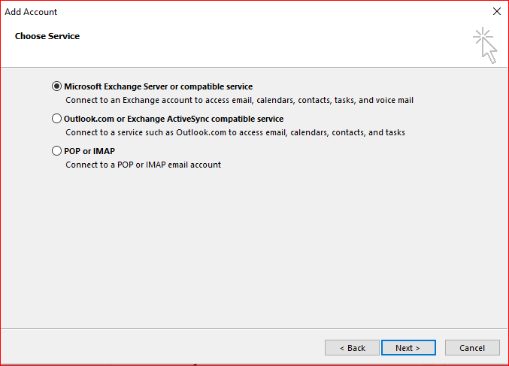
How to activate protocols: outlook

Slide 14
SMTP headers

Slide 15
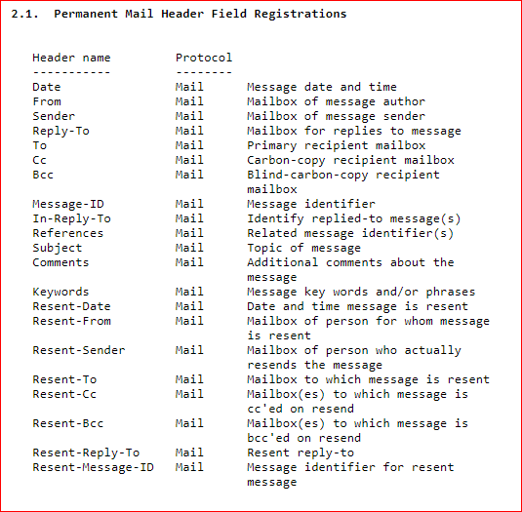
Common e-mail header fields
https://tools.ietf.org/html/rfc4021

Slide 16
Content-Type: application/ms-tnef; name="winmail.dat"
Content-Transfer-Encoding: binary
From: Broadcast Admin and Finance <broadcastadmf@bowiestate.edu>
To: Faculty <Faculty@bowiestate.edu>, Staff <Staff@bowiestate.edu>
Subject: Giant Food and Human Resources Present: Weight Loss and Diets
Thread-Topic: Giant Food and Human Resources Present: Weight Loss and Diets
Thread-Index: AdP9pLaeMBHk87FHR+q+IZXzB82KJQ==
X-MS-Exchange-MessageSentRepresentingType: 1
Date: Wed, 6 Jun 2018 14:45:07 +0000
Message-ID: <MW2PR16MB217024133D5B01E34E2BB0ECCE650@MW2PR16MB2170.namprd16.prod.outlook.com>

Slide 17
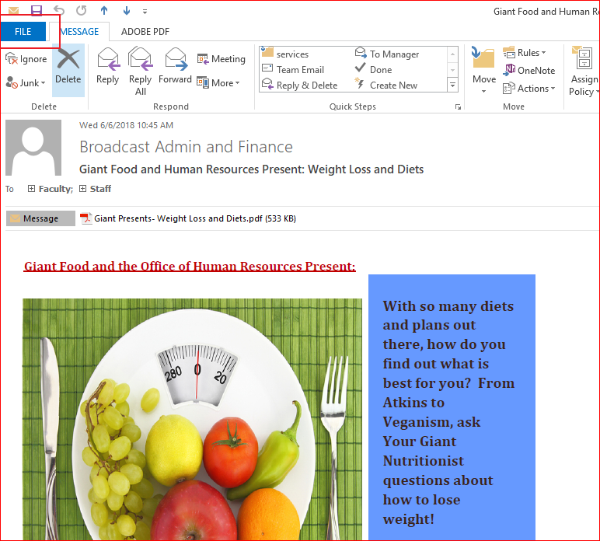
Get Outlook SMTP headers

Slide 18
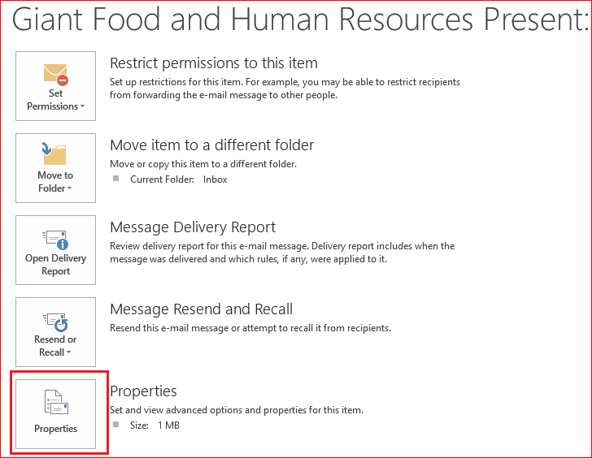

Slide 19
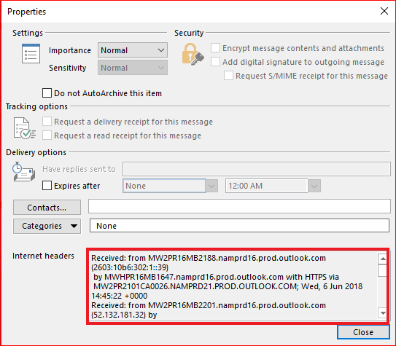

Slide 20
Received: from MW2PR16MB2188.namprd16.prod.outlook.com (2603:10b6:302:1::39)
by MWHPR16MB1647.namprd16.prod.outlook.com with HTTPS via
MW2PR2101CA0026.NAMPRD21.PROD.OUTLOOK.COM; Wed, 6 Jun 2018 14:45:22 +0000
Received: from MW2PR16MB2201.namprd16.prod.outlook.com (52.132.181.32) by
MW2PR16MB2188.namprd16.prod.outlook.com (52.132.181.31) with Microsoft SMTP
Server (version=TLS1_2, cipher=TLS_ECDHE_RSA_WITH_AES_256_GCM_SHA384) id
15.20.820.15; Wed, 6 Jun 2018 14:45:12 +0000
Authentication-Results: bowiestate.edu; dkim=none (message not signed)
header.d=none;bowiestate.edu; dmarc=none action=none
header.from=bowiestate.edu;
Received: from MW2PR16MB2170.namprd16.prod.outlook.com (52.132.181.25) by
MW2PR16MB2201.namprd16.prod.outlook.com (52.132.181.32) with Microsoft SMTP
Server (version=TLS1_2, cipher=TLS_ECDHE_RSA_WITH_AES_256_GCM_SHA384) id
15.20.820.14; Wed, 6 Jun 2018 14:45:08 +0000
Received: from MW2PR16MB2170.namprd16.prod.outlook.com
([fe80::6d83:59ba:9de5:7e9a]) by MW2PR16MB2170.namprd16.prod.outlook.com
([fe80::6d83:59ba:9de5:7e9a%4]) with mapi id 15.20.0841.011; Wed, 6 Jun 2018
14:45:08 +0000
Content-Type: application/ms-tnef; name="winmail.dat"
Content-Transfer-Encoding: binary
From: Broadcast Admin and Finance <broadcastadmf@bowiestate.edu>
To: Faculty <Faculty@bowiestate.edu>, Staff <Staff@bowiestate.edu>
Subject: Giant Food and Human Resources Present: Weight Loss and Diets
>
x-vipre-scanned: 367DB2FC01068A367DB449

Slide 21
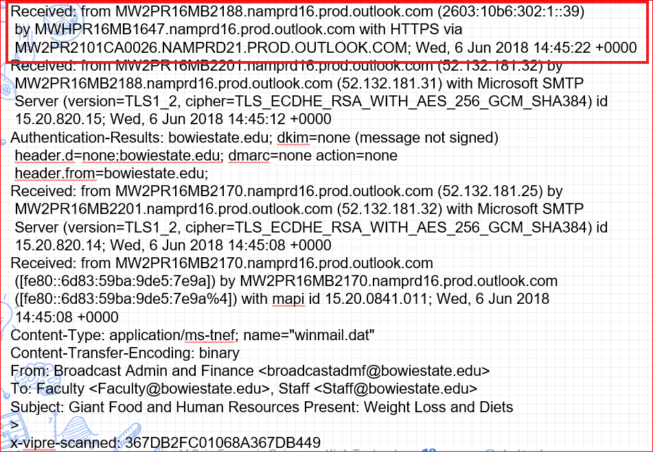
Header Example
Received:
from MW2PR16MB2188.namprd16.prod.outlook.com (2603:10b6:302:1::39)
by MWHPR16MB1647.namprd16.prod.outlook.com with HTTPS
Wed, 6 Jun 2018 14:45:22 +0000
From: the name the sending computer gave for itself (the name associated with that computer's IP address [its IP address])
By: the receiving computer's name (the software that computer uses) (usually Sendmail, qmail or Postfix)
With: protocol (usually SMTP, ESMTP or ESMTPS)
Id: id assigned by local computer for logging;
Timestamp: usually given in the computer's localtime

Slide 22
1. Received: from maroon.pobox.com (maroon.pobox.com [208.72.237.40]) by mailstore.pobox.com
(Postfix) with ESMTP id 847989746 for <address>; Wed, 15 Jun 2011 10:42:09 -0400 (EDT)
2. Received: from maroon.pobox.com (localhost [127.0.0.1]) by maroon.pobox.com (Postfix) with
ESMTP id EA14340A31F; Wed, 15 Jun 2011 10:42:35 -0400 (EDT)
3. Received: from mail-qw0-f46.google.com (mail-qw0-f46.google.com [209.85.216.46]) by
maroon.pobox.com (Postfix) with ESMTPS id 70BCC40A1DB for <address>; Wed, 15 Jun 2011
10:42:13 -0400 (EDT)
4. Received: by qwk3 with SMTP id 3so281681qwk.33 for <address>; Wed, 15 Jun 2011
07:42:11 -0700 (PDT)
5. Received: by 10.229.78.96 with SMTP id j32mr509819qck.121.1308148929825; Wed, 15
Jun 2011 07:42:09 -0700 (PDT)
6. Received: from [10.231.252.223] (79.sub-174-252-72.myvzw.com [174.252.72.79]) by
mx.google.com with ESMTPS id m16sm345129qck.28.2011.06.15.07.42.02
(version=TLSv1/SSLv3 cipher=OTHER); Wed, 15 Jun 2011 07:42:08 -0700 (PDT)
Starting at the top:
A Pobox mailserver (maroon.pobox.com) sent the message to mailstore.pobox.com, which is where I picked it up to read it.
Pobox sent the message internally. This is the step where message filtering happens.
Google (mail-qw0-f46.google.com) sent the message to Pobox.
Google handles the message internally.
Google handles the message internally.
A Verizon server (79.sub-174-252-72.myvzw.com) hands the message to Google.
So, the message starts at Verizon, proceeds through various internal processes at Google and Pobox, then ends up in my Inbox at mailstore!

Slide 23
Retrieve a header of a message
Gmail: Click on the down arrow, next to the Reply button, at the top right corner of the message. Select "Show original".
Hotmail: Click on the down arrow, next to the Reply button, at the top right corner of the message. Select "View Message Source".
Yahoo!: At the bottom right corner of the message, click the link for "Full Headers".
Outlook 2010: Open the email in a separate window. Click the "File" tab. Select the Properties button. They are in the Internet Headers box.
Outlook 2007: Click on the small arrow to the right of Options. They are in the Internet headers box.
Outlook 2003: Right clicking on the message from your mailbox and select Options. They are in the Internet Headers box.
Webmail: Open the message for the header you would like to view > Click the 'More' drop down box in the top right of the message > Click 'Show Raw Message'.
Thunderbird: Click View > Message Source.
Mac Mail.app: Click View->Message->Full Headers, or Shift-Command-H.
Microsoft Exchange: Click on File->Properties->Internet.
Eudora Pro: Go to the toolbar just above the message, and click the button that reads "blah blah blah".
AOL Mail: Right click on the message, then select "View Message Source".
Mutt: Hit "h".
Pegasus E-mail: press Ctrl-H.

Slide 24
Spam/Fake Analysis

Slide 25
Spam/Fake Header: Open mail relay
An open mail relay is an SMTP server configured in such a way that it allows anyone on the Internet to send e-mail through it,
not just mail destined to or originating from known users
This used to be the default configuration in many mail servers;
indeed, it was the way the Internet was initially set up
Open mail relays have become unpopular
because of their exploitation by spammers and worms.
many relays were closed, or were placed on blacklists by other servers.

Slide 26
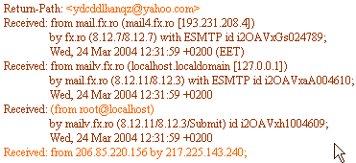
Spam Header
Received tags: read them from the bottom to top. The header says the email was originally sent from 206.85... and it was sent to 217.225... (which is the name/IP of the first mail server that got involved into transporting this message). Then suddenly, the next Received tag says the message was received from root@localhost, by mailv.fx.ro. You can also notice that so far, the Received tags do not contain any information about how the email was transmitted (the "with" tag is missing)

Slide 27
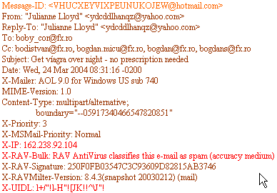
Spam Header
The Message-ID field is a unique identifier of each email message.
It is like the tracing ID of an express postal mail.
The rule says the ID is composed by the name of the server that assigned the ID and a unique string (for example, QESADJHO@emailaddressmanager.com).
Hmm, this is strange, because on our case, the ID belongs to hotmail.com, while the sender appears to belong to yahoo.com. In fact, this difference mainly shows that the sender is forged (fake address or someone pretending to own that email address).

Slide 28
Spam Header
The X-IP tag (also named X-Originating-IP) is probably the most important one and it should give precise information about the sender (from where the email was actually sent). Unfortunately, this tag is optional for email protocols, so some spam messages will not include it. As you can see, the originating IP is not even close to the sender's IP, from the Received tags.

Slide 29
Reference
https://cr.yp.to/immhf/envelope.html
http://www.emailaddressmanager.com/tips/spam-header.html
https://www.pobox.com/helpspot/index.php?pg=kb.printer.friendly&id=22
https://en.wikipedia.org/wiki/Open_mail_relay

Slide 30
Outlook PST files
Personal Storage Table files

Slide 31
Personal Storage Table or Personal Folders File
Is a file where Microsoft Outlook stores all of your Outlook items: Email, Calendar events, Contacts, Tasks and other.
After you setup your account in Microsoft Outlook it will automatically create a PST file and associate it with your created account.

Slide 32
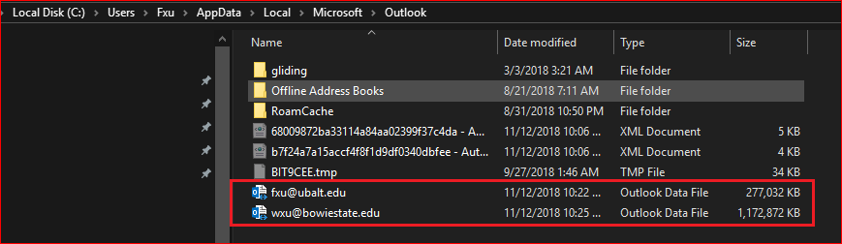
Where is a PST file located?

Slide 33
Extract Emails

Slide 34
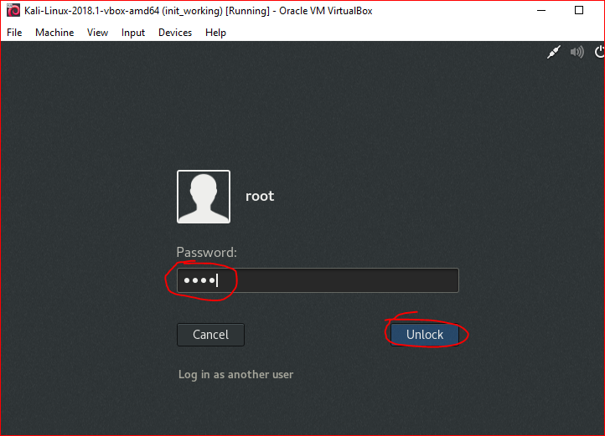

Slide 35
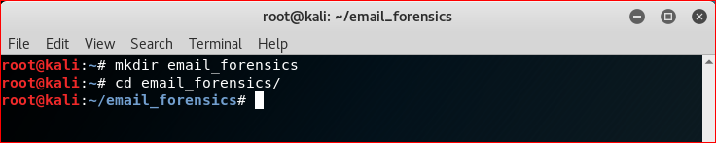

Slide 36
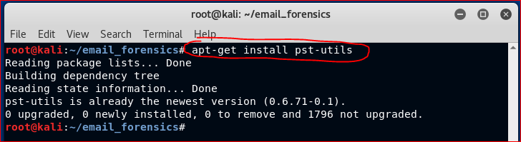

Slide 37
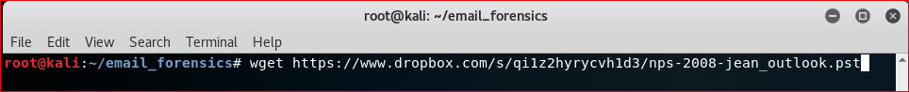
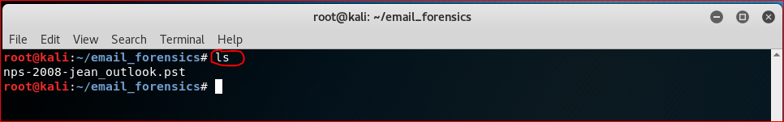
https://www.dropbox.com/s/qi1z2hyrycvh1d3/nps-2008-jean_outlook.pst

Slide 38
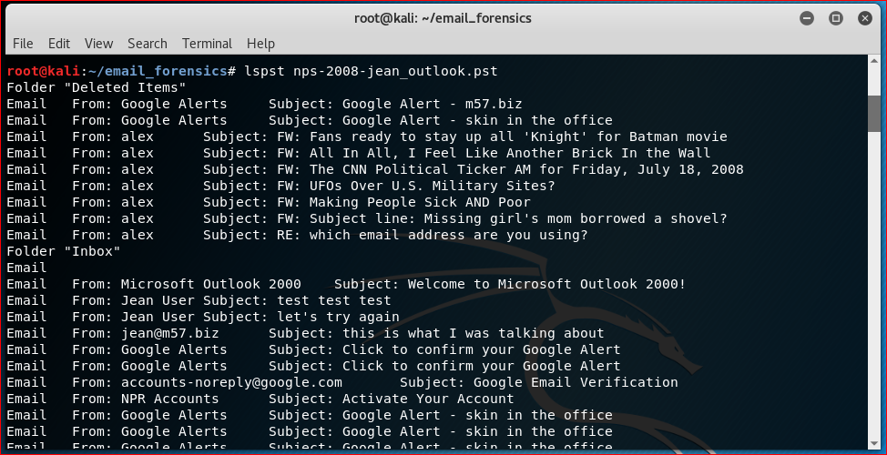

Slide 39
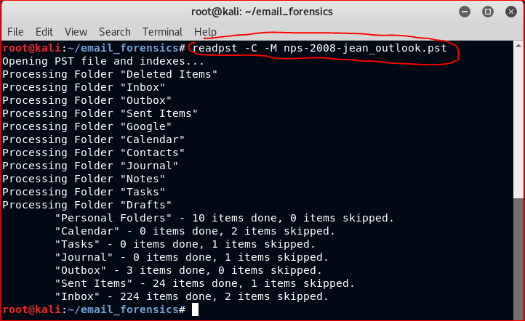
-C = standard character set
-M = output messages RFC 822 format (test messages) as separate files

Slide 40
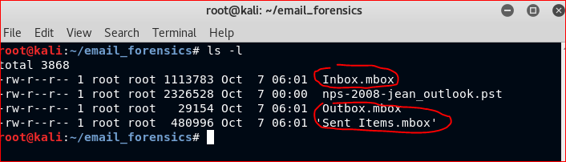

Slide 41
Extract Images

Slide 42
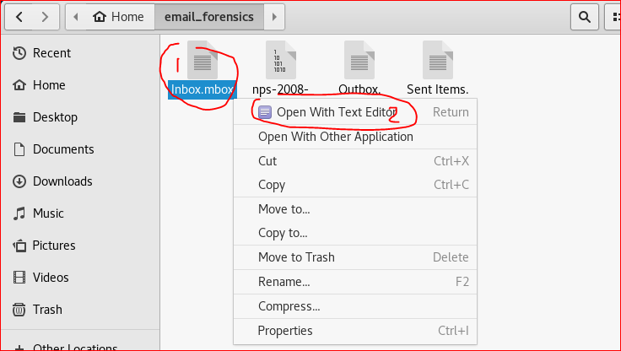
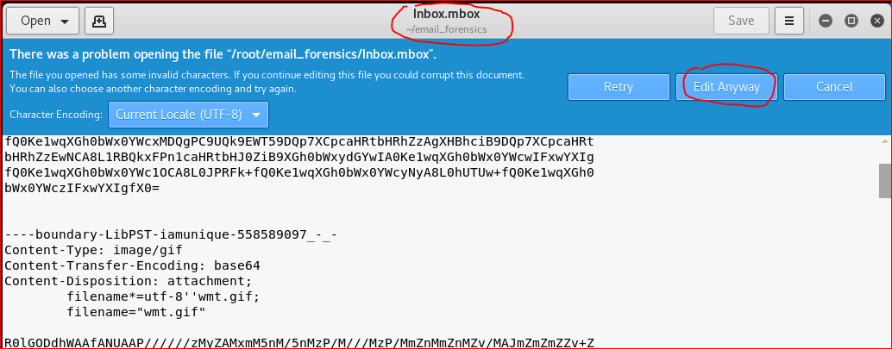

Slide 43
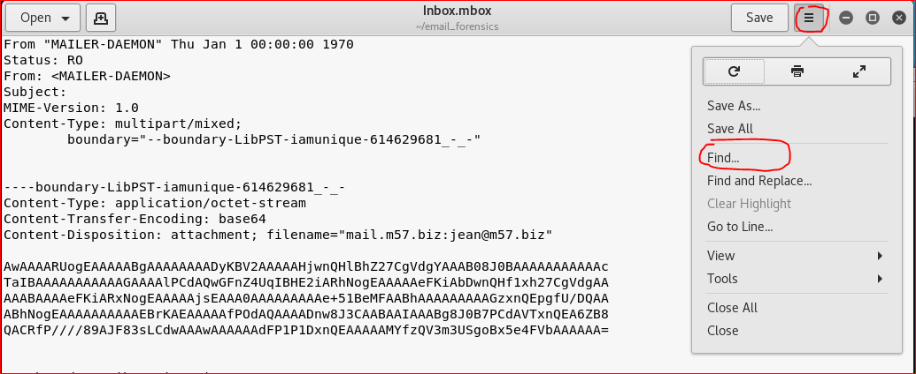

Slide 44
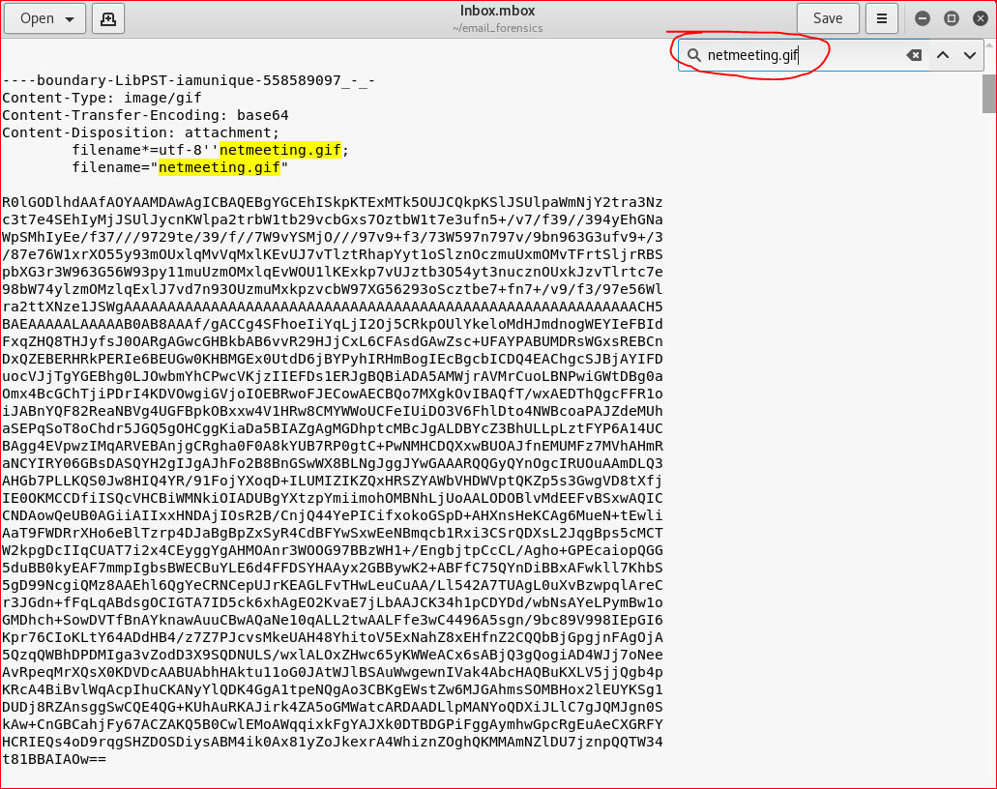
SMTP can’t transmit anything other than ASCII characters therefore attachments are encoded with Base64 encoding to translate non-ascii into ASCII for transmission.

Slide 45
What is Content-Transfer-Encoding?
SMTP, by definition (RFC 821), limits mail to lines of 1000 characters of 7 bits each. That means that none of the bytes you send down the pipe can have the most significant ("highest-order") bit set to "1".
The content that we want to send will often not obey this restriction inherently. Think of an image file, or a text file that contains Unicode characters: the bytes of these files will often have their 8th bit set to "1". SMTP doesn't allow this, so you need to use "transfer encoding" to describe how you've worked around the mismatch.
The values for the Content-Transfer-Encoding header describe the rule that you've chosen to solve this problem.

Slide 46
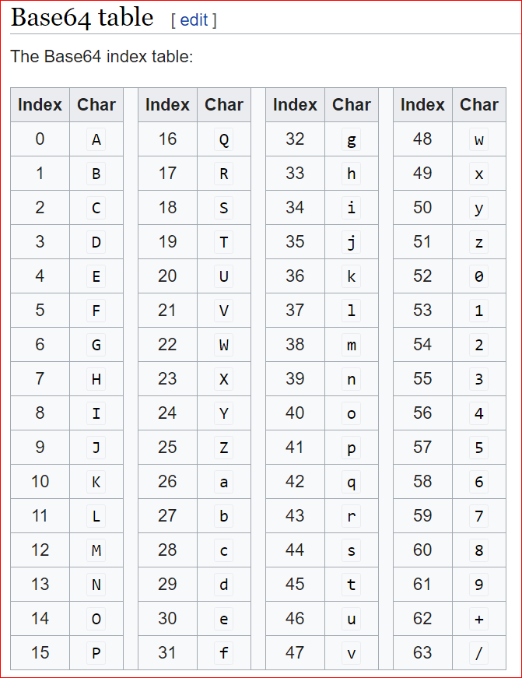

Slide 47
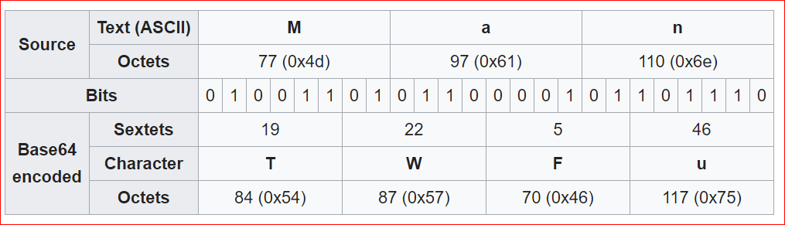

Slide 48
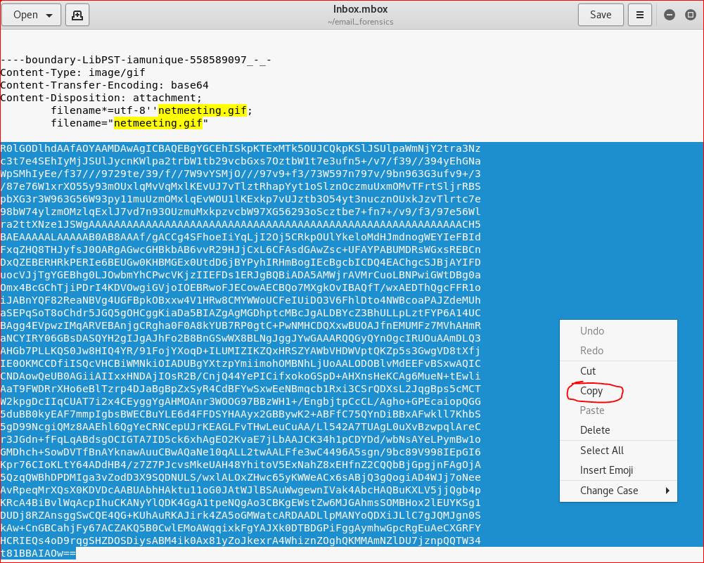

Slide 49
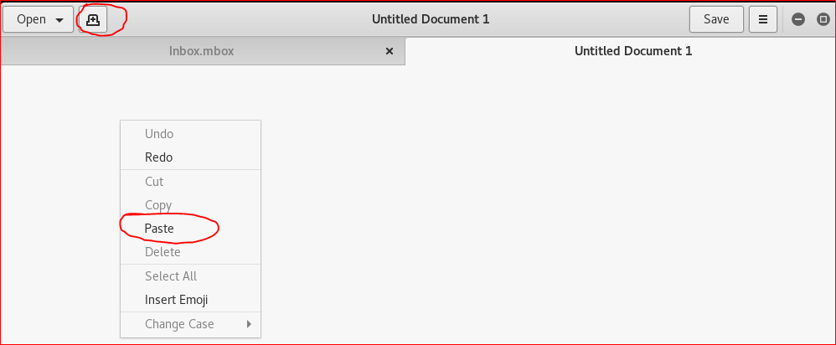

Slide 50
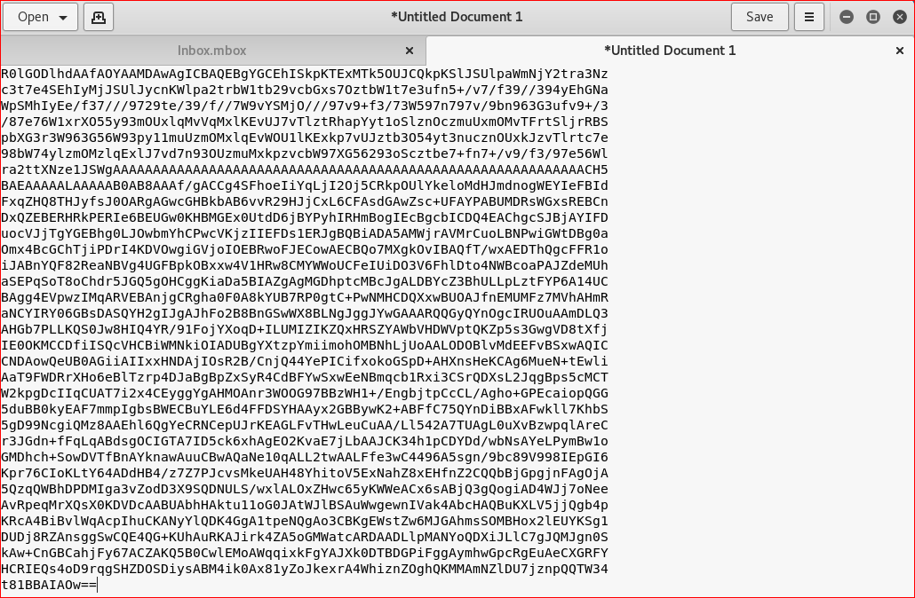

Slide 51
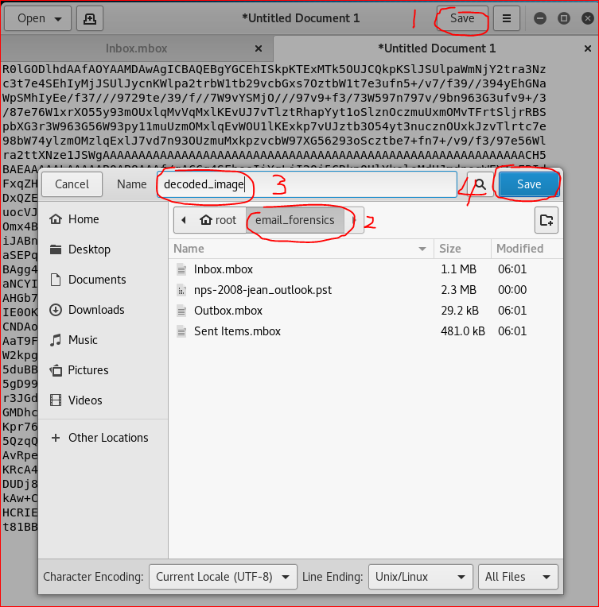

Slide 52
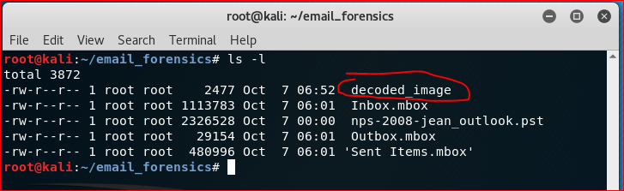

Slide 53
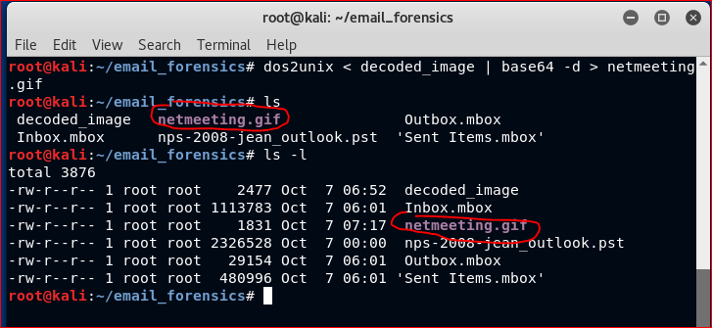

Slide 54
dos2unix
Sometimes, you will need to move files between windows and Unix systems. Window files use the same format as Dos, where the end of line is signified by two characters, Carriage Return or CR or \r followed by Line Feed or LF or \n.
Unix files use only Line Feed (\n).
https://www.geeksforgeeks.org/dos2unix-unix2dos-commands/

Slide 55
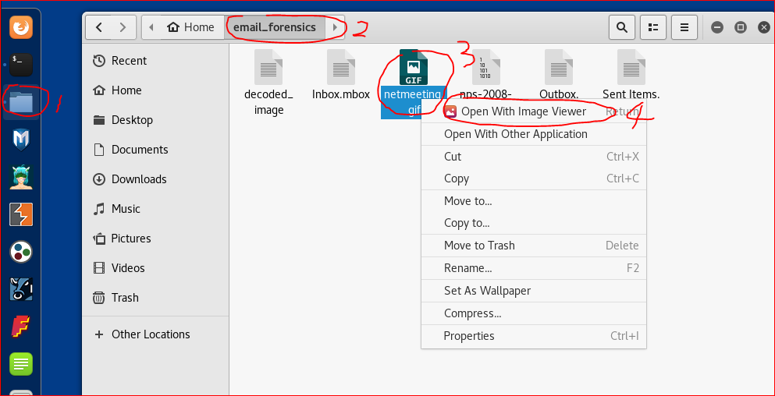

Slide 56
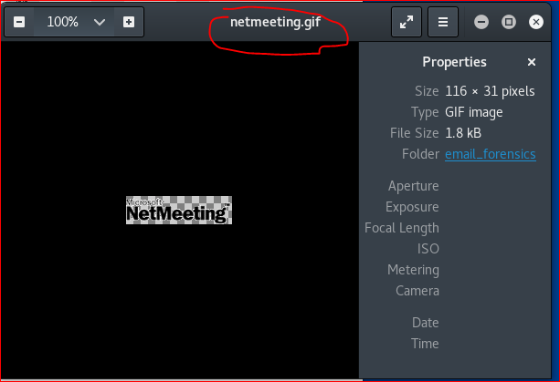

Slide 58
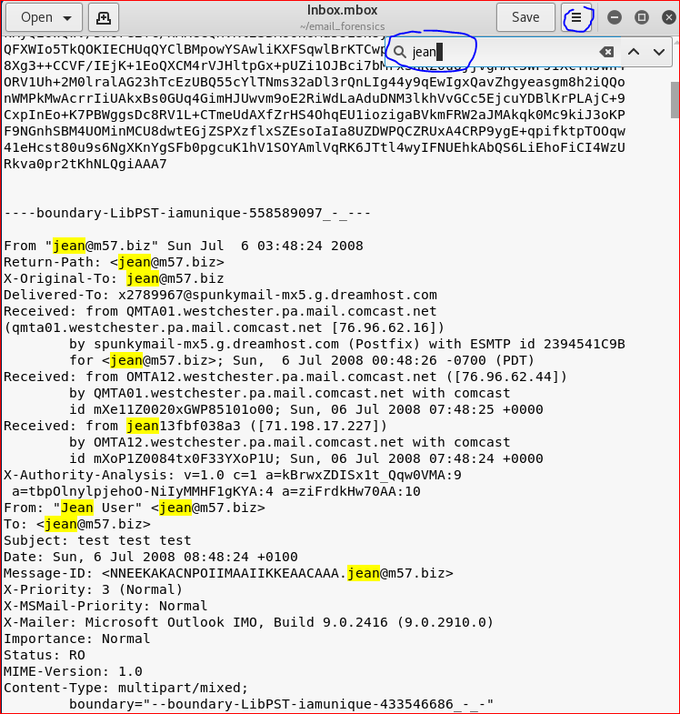

Slide 59
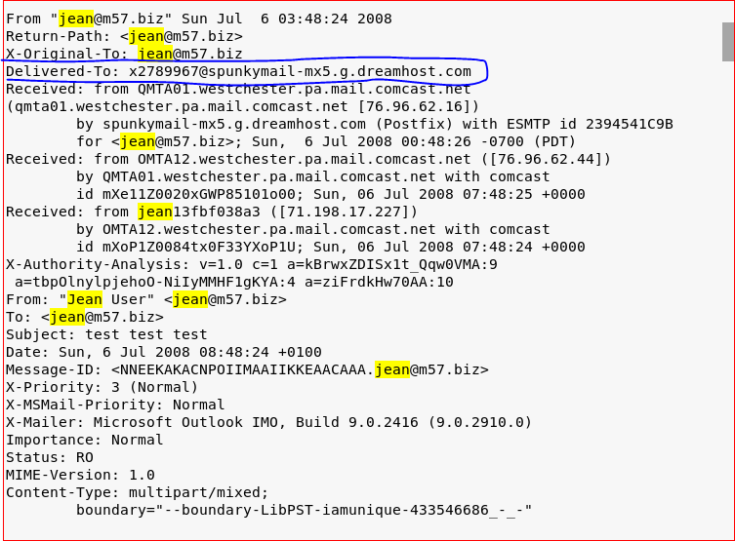
the incoming SMTP server of the message that it was delivered

Slide 60
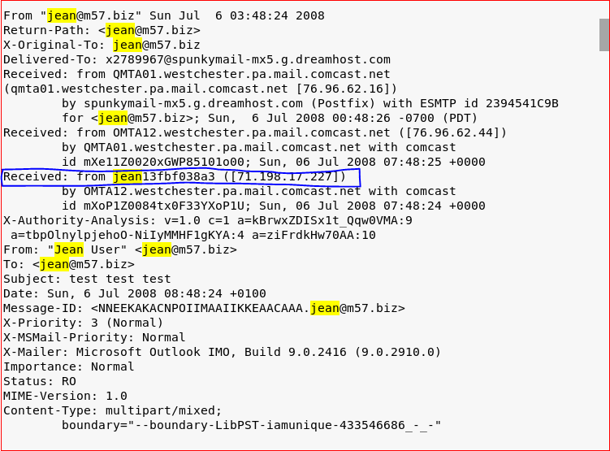
the originator of the message as well as the SMTP server

Slide 61
Your Work

Slide 62
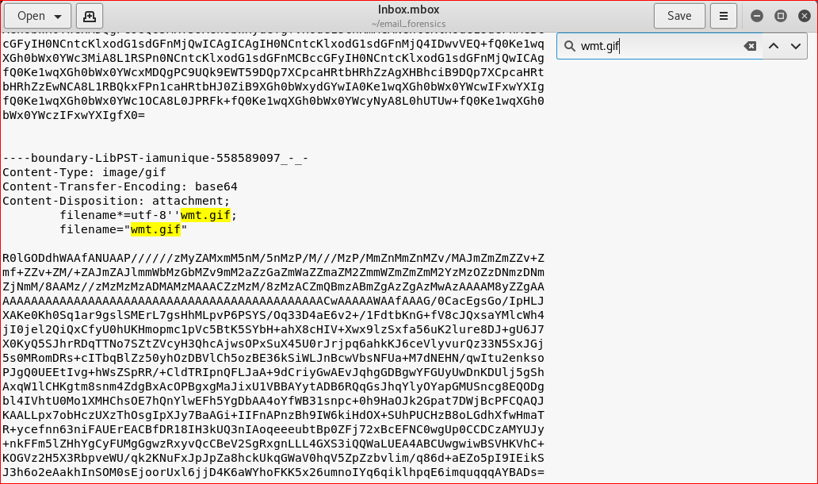
Retrieve wmt.gif

Slide 63
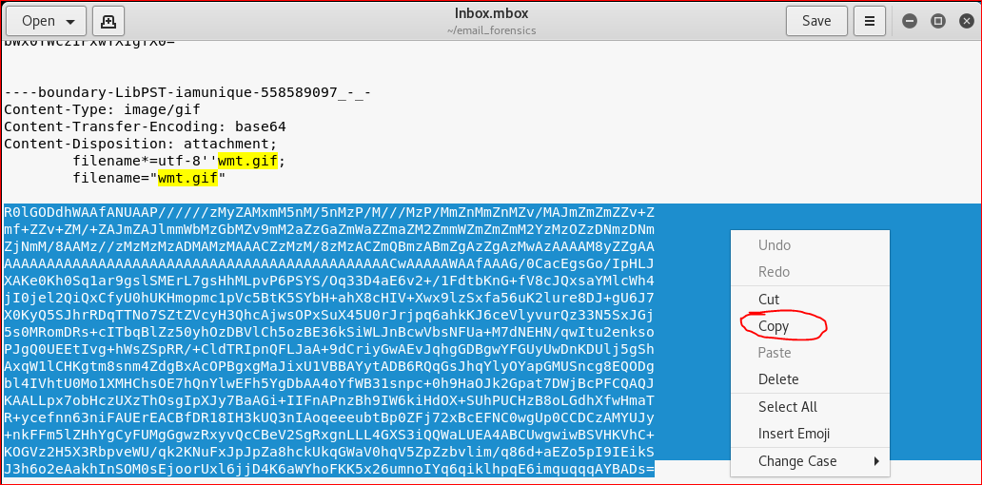

Slide 64
More question
Find the travel path of the email.

